Slide 1
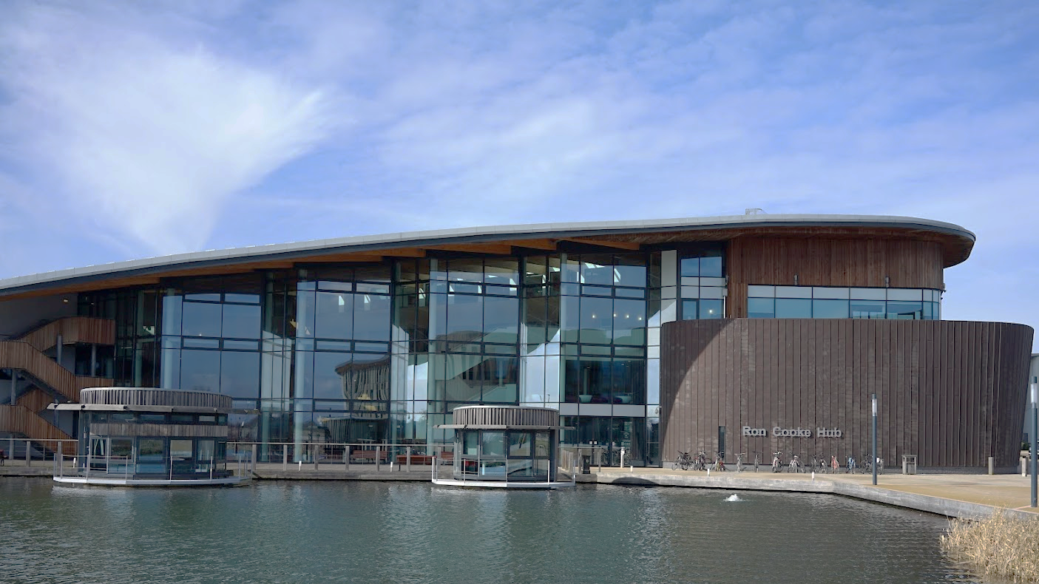
Digital Twin for Modelling and Optimizing Industrial Multi- and Many-Core Systems
Xiaotian Dai, Shuai Zhao, Iain Bate, Alan Burns
xiaotian.dai@york.ac.uk
Real-Time Systems Research Group University of York Nov 2021

Slide 2
Contents of this talk
Background of MOCHA project
Challenges in many-core real-time systems
Digital twin to achieve adaptation in E/RTS
Current research and key problems to solve
Research plan

Slide 3
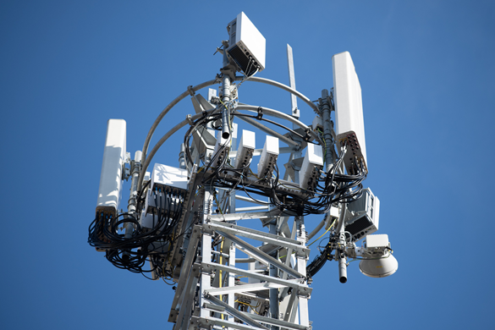
MOCHA Modelling and Optimizing Complex Heterogenous Architectures
Collaboration between UoY and Huawei
Working on 5G base stations.
Funding size: £985,927
Dec 2019 – Dec 2022
https://www.cs.york.ac.uk/rts/mocha/

Slide 4
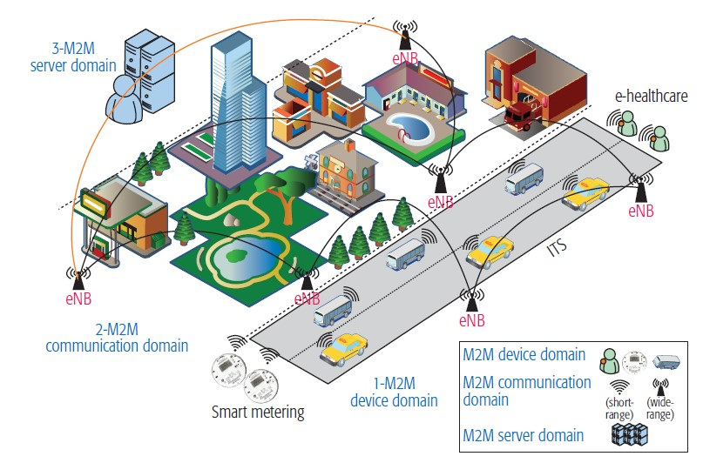
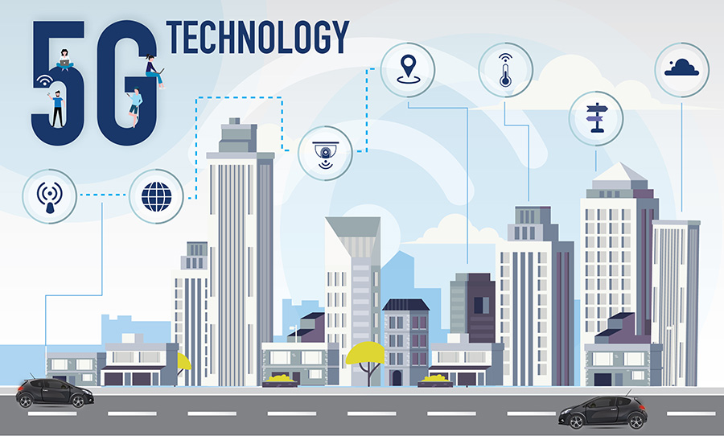
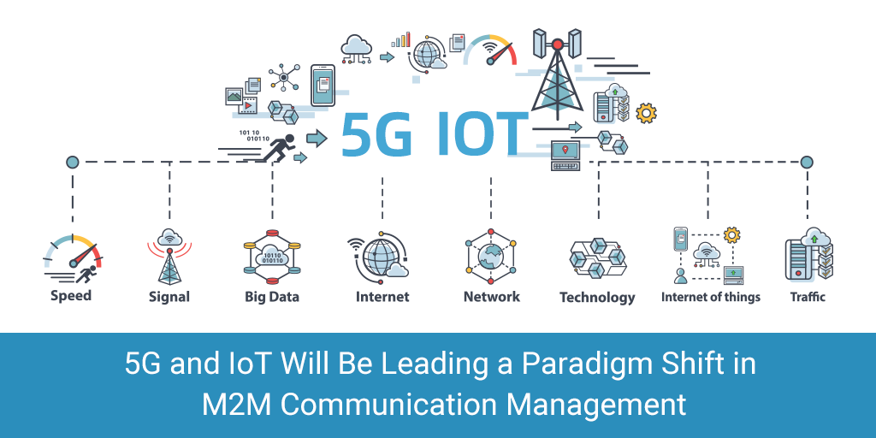
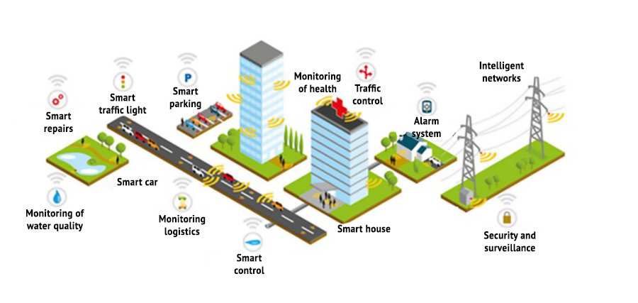
Background - 5G Communication

Slide 5
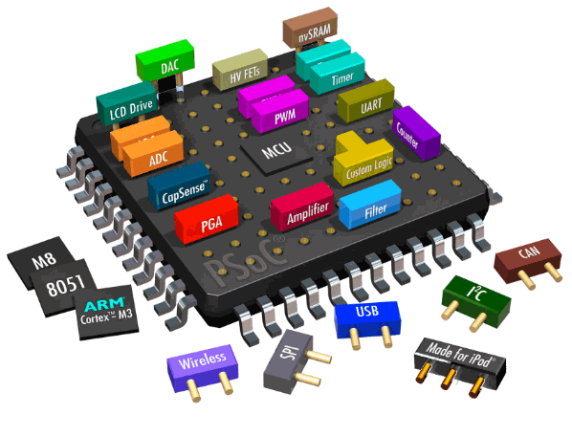
Background - Research Goals
Working on the next-generation of 5G base stations to meet the increasing computing demands and timing requirements.
General methods and tools that can be applied to similar systems.
Towards trustworthy many-core systems (# of cores is more than 16).
I. Digital Twin
II. Modelling
MOCHA
III. Scheduling and Allocation Research

Slide 6
Challenges in many-core real-time systems
Systems are designed and verified with models, but these models could be inaccurate/ invalidated.
The number of cores keeps increasing for industrial embedded devices or “edge” computing, with flexible yet complex architecture – parallelism and interference need to be further explored.
Working environment is subjected to more uncertainties, which is hard to be predicted at design-time. However, design decisions have to be made before hardware is being made available.
Demand on enhancing predictability, adaptiveness and performance (e.g. by better use of cache.).
Assuring that the system has meet the timing requirements. For example, URLLC (ultra-reliable low latency communications) has a deadline requirement of 1 ms.
Notes:
I would make this more specific. Think about what Huawei wanted us to do – helping planning hardware etc, help enhancing predictability, better use of the cache, assurance arguments
Then, on the next slide you can talk about Digital Twin and how this is an ideal way to reason about this before deployment and then after deployment

Slide 7
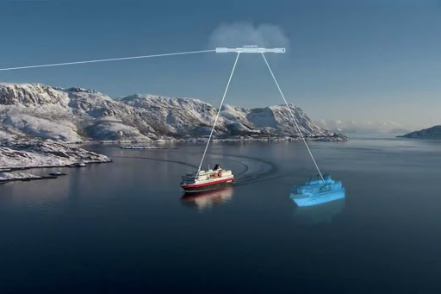
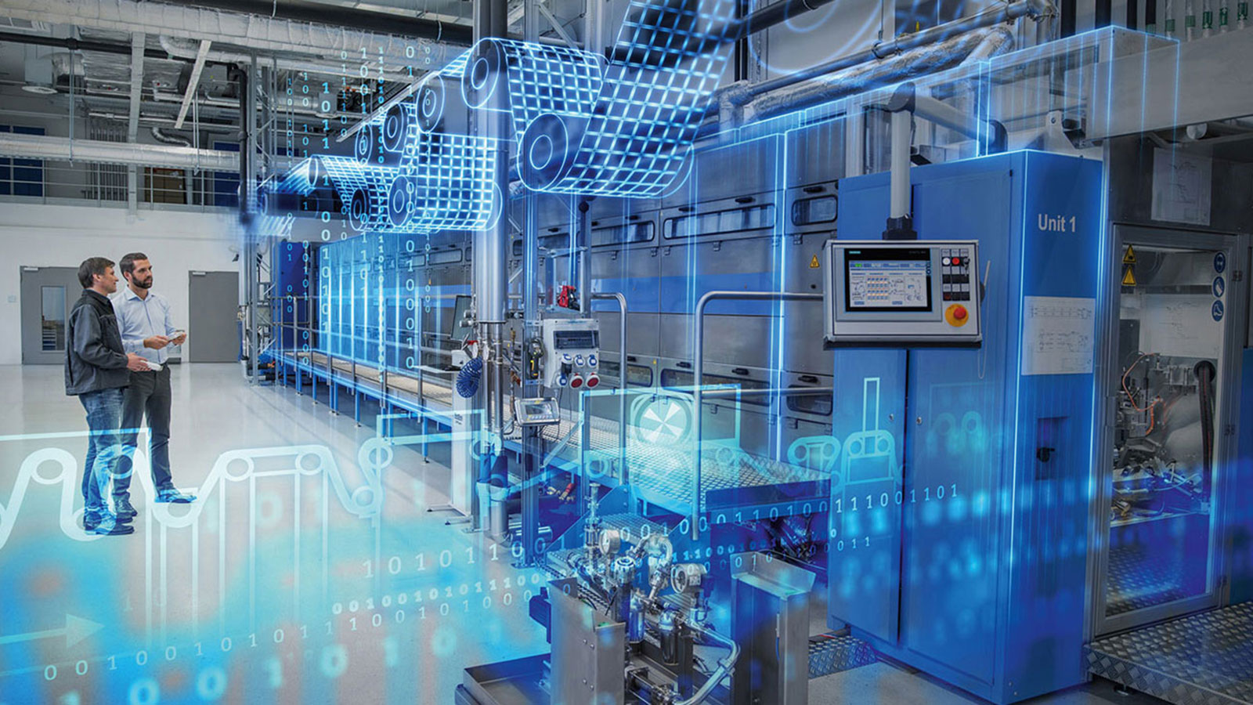
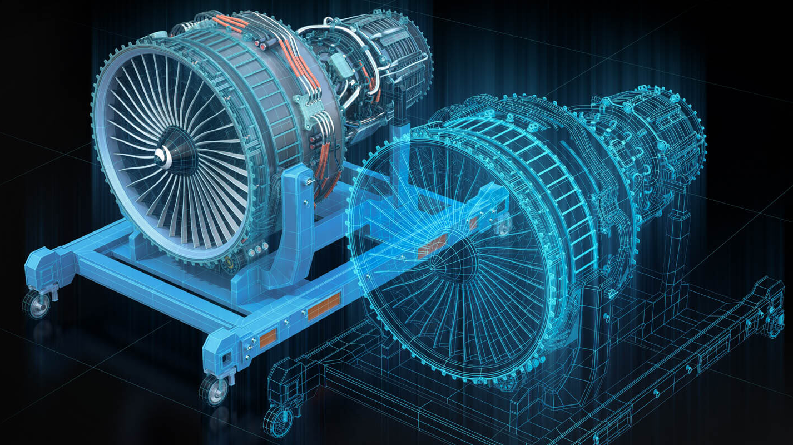
Digital Twin (DT) in Industrial Systems
“A digital twin is a virtual representation that serves as the real-time digital counterpart of a physical object or process.”
Attempts have been made in space and avionics, transportation, industrial automation, medical systems and autonomous driving.
DT is an ideal way of verifying a system before it is deployed, and through its life-cycle (more than a simulator).
Digital Twin for Maritime Transportation
Digital Twin for Process Control
Digital Twin for Avionic Engine Design and Control
Notes:
Talk here about what they actually do with them so it closes the circle back to our potential use of them

Slide 8
DT for Embedded/Real-Time System
However, DT is not considered as much in E/RT systems.
In our vision, DT can be helpful from two perspectives:
Design-time: fast evaluation and exploration with approximated models;
Run-time: refinement through observations from the real system.
When applying the DT, we have these principles in mind:
Efficiency --- a satisfactory model without full coverage profiling.
Acceptability --- following engineering practice and reduce efforts.

Slide 9
DT for Embedded/Real-Time System
In our previous RTAS’21 paper, we introduced five key challenges to adopt Digital Twin in real-time multi-core systems:
C1 - Determining the Key Parameters for the Range of Operational Usage
C2 - Achieving Sufficient Coverage in an Efficient Manner
C3 - Creating Representative Models Supporting Reliability Assessment
C4 - Managing Uncertainties as Part of Establishing Confidence
C5 - Robust Decision Making in the Presence of Inaccuracies
The success of a Digital Twin largely depends on the solutions to these challenges.
[1] X. Dai, et al. “Brief Industry Paper: Digital Twin for Dependable Multi-Core Real-Time Systems---Requirements and Open Challenges”. RTAS. 2021.

Slide 10
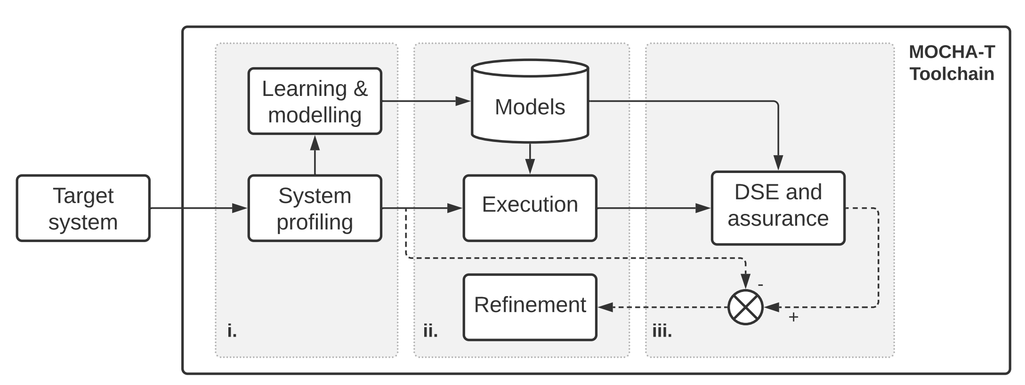
Current Research and Key Problems
Aiming at using Digital Twin for modelling high performance/ reliability multi-core embedded systems, as a mitigation solution to modelling errors, and to achieve adaptation of scheduling.
Profiling
Physical System
Modelling
Digital Twin
Learning
Simulation
Refinement

Slide 11
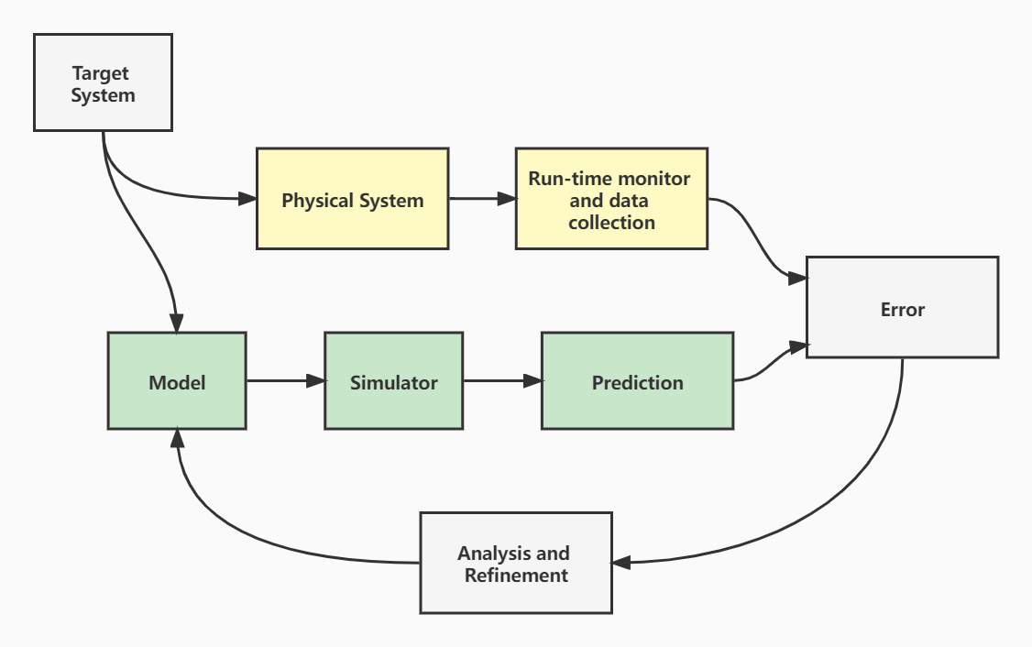
Current Research and Key Problems
Execution Time Model (ETM)
The system initially has a relatively simple model, i.e., without considering multi-core and OS interference.
Once the system is up and running, operational data can be collected. The comparison of the real data and the output from the model will produce some error.
The output from the model is produced by some prediction-based method, e.g., from a simulator in our case
The error would be collected, analyzed and modelled, by an run-time learning process.
The error model can then be used to improve the digital twin.

Slide 12
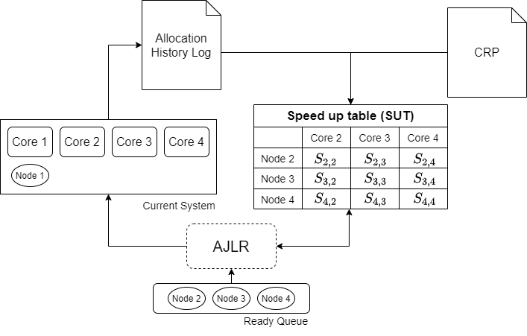
Current Research and Key Problems
Decide the error is anomaly or not (C.1/C.2).
Decide from which source the error is coming from (C.3).
Evaluate the impact of an error (C.4).
Partial information / execution scenarios / confidence / level of tolerance (C.5).
Engineers would be in the loop when critical decisions have to be made to mitigate, e.g. changing level of abstraction (C.5).
Notes:
Slide 6 already defines the problem so this slide should clearly link to that, i.e. now we have built a twin CX has the specific challenges of X

Slide 13
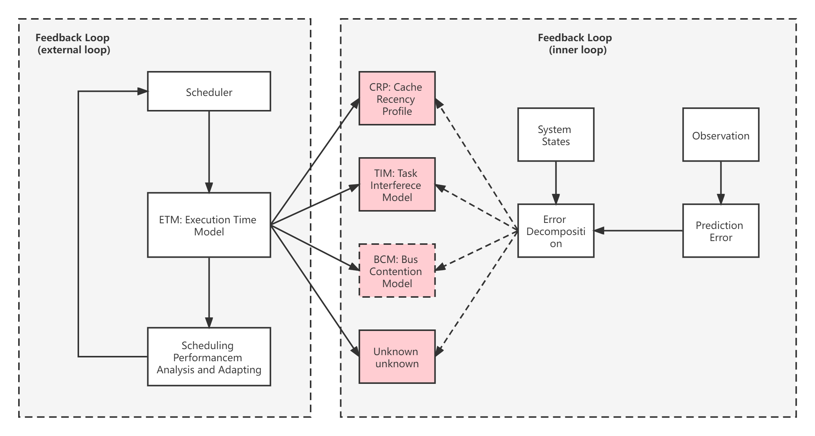
Current Research and Key Problems
Explanation-based learning: Error decomposition and reasoning.

Slide 14
Research Plan
Short-term plan
Make a workable prototype digital twin that can adapt errors, and improve the system model by changing, for example, the parameters of the underlying models.
Use the DT to improve scheduling and allocation decisions.
Long-term plan
How we can adapt this method, not just for modelling and scheduling, but also for other purposes to answer “what if” questions. For example, design space exploration (DSE).

Slide 15
Questions and Discussions
Thank you!
Dr. Xiaotian Dai (xiaotian.dai@york.ac.uk)

