Slide 1
Semi-partitioned Model on Dual-core Mixed Criticality System
Hao Xu

Slide 2
Background
Mixed Criticality System
Task has different Worst Case Execution Time (C) for different criticality levels (L)
For the same task:
L_{m} > L_{n} => C_{m} > C_{n}
Two criticality levels (HI, LO)
HI > LO

Slide 3
Background
Vestal’s Approach^{[1]}
All tasks keeps schedulable
Pessimistic
Runtime monitors
LO-crit task -> prevent from execution
HI-crit task -> mode change
AMC^{[2]} and EDF-VD^{[3]} etc.
[1] S. Vestal. Preemptive scheduling of multi-criticality systems with varying degrees of execution time assurance. In Real-Time Systems Symposium, 2007. RTSS 2007. 28th IEEE International, pages 239–243. IEEE, 2007. [2] S. K. Baruah, A. Burns, and R. I. Davis. Response-time analysis for mixed criticality systems. In Real-Time Systems Symposium, pages 34–43. IEEE, 2011. [3] S. Baruah, H. Li, and L. Stougie. Towards the design of certifiable mixed-criticality systems. In Real-Time and Embedded Technology and Applications Symposium (RTAS), pages 13–22. IEEE, 2010.

Slide 4
Motivation
Explore a way that all of the tasks remain schedulable throughout the criticality level changes.
Multi-core platform provides the option of migration

Slide 5
Assumptions
Independent tasks
Deadline < period
Migration cost
Mode change frequency and isolation

Slide 6
Semi-partitioned Model
MIG₁
MIG₁
MIG₂
LO₁
MIG₂
LO₁
LO₂
LO₂
HI₁
HI₁
HI₂
HI₂
Core 1
Core 2
Core 1
Core 2

Slide 7
Semi-partitioned Model
If all tasks execute within their LO-crit budget then all deadlines are met and no tasks migrate.
No LO-crit task is allowed to exceed its LO-crit budget.
If HI-crit tasks on one core exceed their LO-crit budget, then some LO-crit tasks will migrate, but ALL LO-crit tasks and HI-crit tasks remain schedulable.
If HI-crit tasks on more than one core exceed their LO-crit budget, then some LO-crit tasks will be abandoned, but all HI-crit tasks remain schedulable (without migration).

Slide 8
State View
Task set S to represent the collection of all tasks sets:
S = (LO₁ U LO₂) U (HI₁ U HI₂) U (MIG₁ U MIG₂)
State X to represent the normal execution state:
X₁ = LO₁ U HI₁ U MIG₁
X₂ = LO₂ U HI₂ U MIG₂
S = X₁ U X₂

Slide 9
One core enters HI-crit Mode
State Y(1) to represent the state that Core c₁ enters HI-crit mode.
Y(1)₁ = LO₁ U HI₁
Y(1)₂ = LO₂ U HI₂ U MIG₁ U MIG₂
S = Y(1)₁ U Y(1)₂
Release Jitter and Reduced deadline issues for migrating tasks (MIG₁)

Slide 10
Release Jitter Issue
Task released at time t₀ and migrates at time t
t₀ + R
t₀
t
t₀ + T
t₀ + 2T
t₀ + 3T
t₀ + D

Slide 11
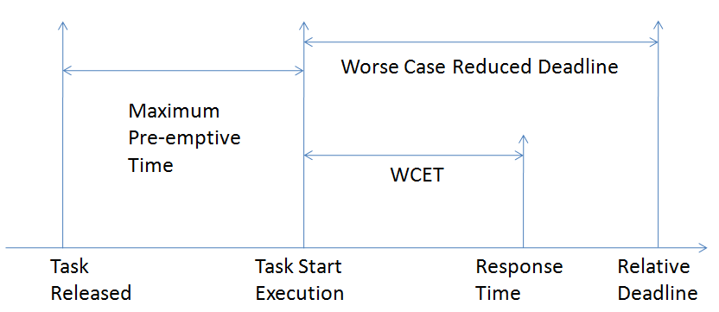
Reduced Deadline Issue
d_{i}’_{max} = d_{i} - (R_{i}(LO) - C_{i})

Slide 12
Both Cores in HI-crit Mode (1)
BY(1) to represent the case that core c₂ also enters HI-crit mode from state Y(1)
BY(1)1 = LO₁ U HI₁
BY(1)2 = HI₂
S = BY(1)₁ U BY(1)₂ U LO₂ U MIG₁ U MIG₂

Slide 13
Both Cores in HI-crit Mode (2)
BX to represent the case that both cores enter HI-crit mode at the same time.
BX1 = LO₁ U HI₁
BX2 = LO₂ U HI₂
S = BX₁ U BX₂ U MIG₁ U MIG₂

Slide 14
Allocation
Bin packing algorithms
Criticality aware utilisation decreasing g
Non-migration
Migration

Slide 15
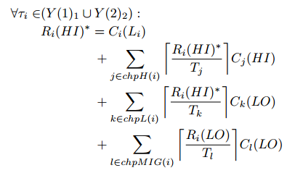
Choice of Migration
Regarding to the equation:
Migrating LO-crit
tasks with largest
slack time
Schedulability issues after migration

Slide 16
Semi-partitioned Model Configuration
Two approaches on deciding migrating tasks
Semi1: task fetched
Semi2: task assigned
Three bin-packing algorithms
FF, BF, WF
Audeslay’s priority assignment

Slide 17
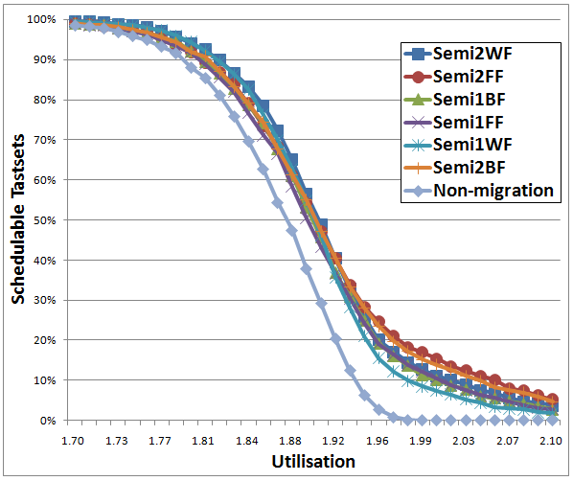
Evaluation
f = 3
P = 0.5
n = 12
ts=10000

Slide 18
Evaluation
Weighted graphs
Taskset size
Percentage of HI-crit tasks
Factor of WCET differences
All algorithms behave better than the non-migration algorithm
Semi2WF and Semi2FF

Slide 19
Conclusion
Semi-partitioned model
Six possible approaches
A combination usage of two algorithms

