Slide 1
SCJ and EV3 Robots
Leadership Election

Slide 2
Background
Safety Critical Java
  A safety critical programming model in Java
EV3 mindstorms Lego Robot
  A robot toy that has a Linux running on it.
Leadership Election Algorithm
  An algorithm that applies to distributed systems and aims to elect a stable leader.

Slide 3
To implement the algorithm, we need
A Robot Layer (provided by icecap)
  Contains a set of interfaces to control the robot i.e. the motors.
A Network Layer (we implemented it)
  One or more sets (e.g. TCP and UDP) of interfaces to provide the network facilities.
A protocol layer
  Contains the implementation of the leader election protocol.

Slide 4
Implementation
We carried out:
  2 soft architecture solutions
    Sequential
    Concurrent
  2 network protocols
    TCP (connection oriented, reliable network)
    UDP (connectionless)
  3 programming models
    Single mission
    Multi missions
    Nested missions

Slide 5
Different Software Architecture Solutions
“Sequential” Architecture
  Application consists of a single periodic event handler to implement the protocol
  But needs multiple managed threads to handle the network connection
  Single Mission
  TCP
Concurrent Architecture
  Each thread is responsible for a specific task (e.g. send/receive state, execute the election protocol).
  Multi missions and nested missions.
  TCP and UDP

Slide 6
Sequential Architecture Code Explanation

Slide 7
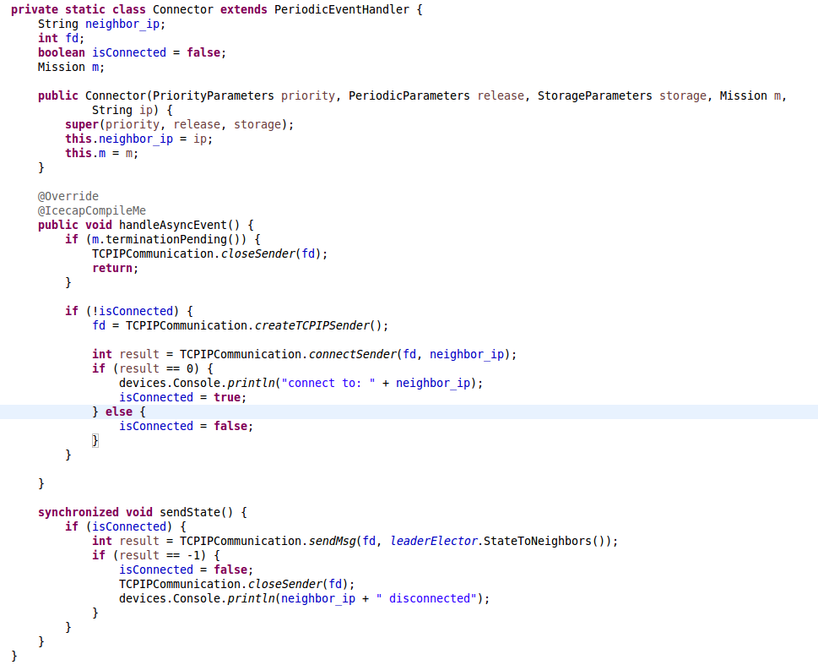
Connector

Slide 8
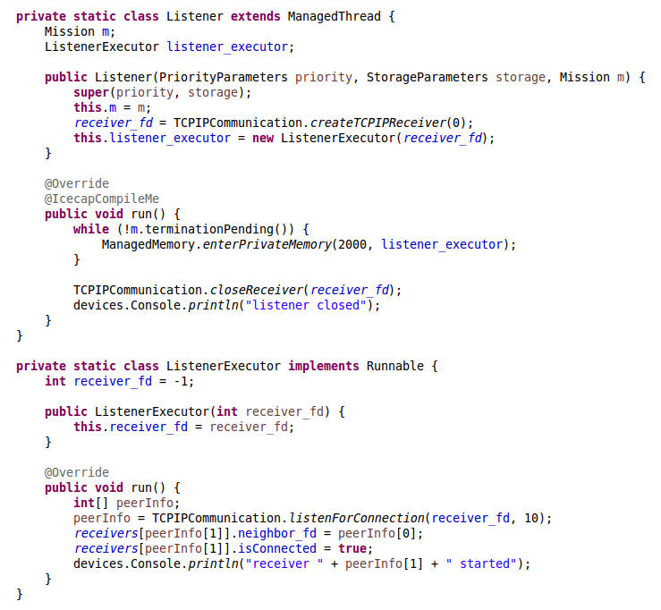
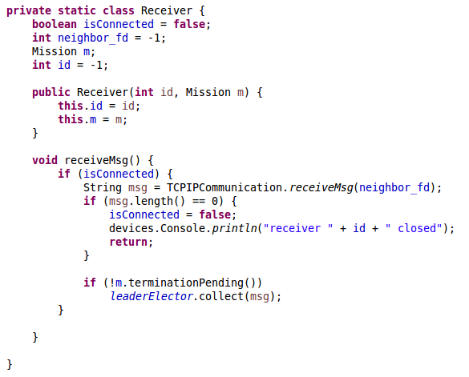
Listener

Slide 9
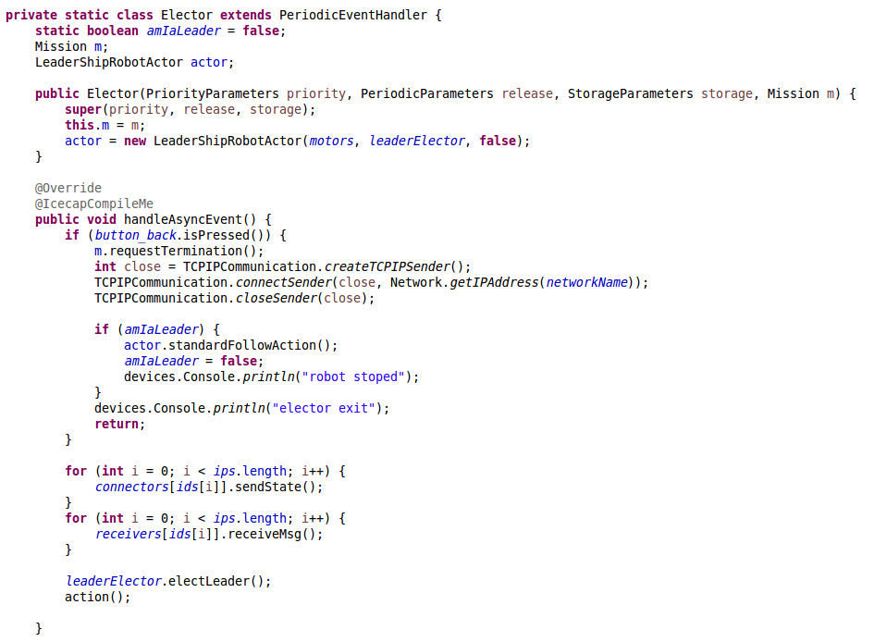
Elector – The Sequential election procedure

Slide 10
Demonstration 1
The Sequential Architecture with 3 robots
  Robot Behavior:
    Step forward if a robot becomes a leader
    Step backward if a robot becomes a follower or be turned off
    Do nothing if its state is not changed
    Shut down (a simulation of turn off) the program if its “Back” button is pressed

Slide 11
However, the robots looks like zombies in Such movements )-: …

Slide 12
EV3 Command and Follow Feature
A EV3 command protocol is introduced
A command decoder is implemented.
Each robot has a EV3 command decoder
  The leader will send commands to followers
  Followers decode the commands and then execute them.
Two Architectures are implemented with this feature
  The concurrent single mission architecture
  The “sequential” architecture

Slide 13
Demonstration 2
The Concurrent Architecture with “command and follow” feature
  Mission: Imitate the leader
    Each robot may have a heart of leader ☺.
  Robot Behavior:
    The leader has a set of movements.
    After each movement, all the followers will move exactly as the leader did.

Slide 14
Thank you!

