Slide 1


Creating Safety Assurance Cases for Rebreather Systems
Alma L. Juarez – University of Waterloo
Bruce G. Partridge – Shearwater Research Inc.
Jeffrey J. Joyce – Critical Systems Labs Inc.
ASSURE 2013 Workshop
May 19, 2013


Slide 2
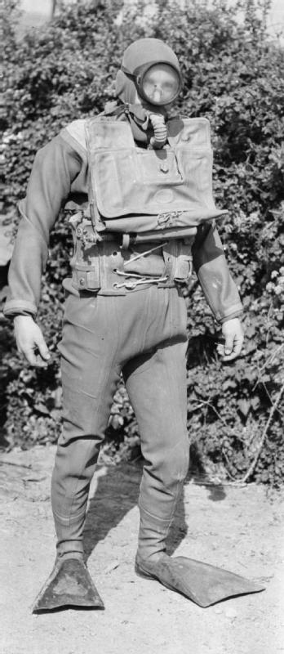
Rebreathers
Rebreather: self-contained underwater breathing apparatus.
ASSURE 2013 Workshop  Creating Safety Assurance Cases for Rebreather Systems  2

Slide 3
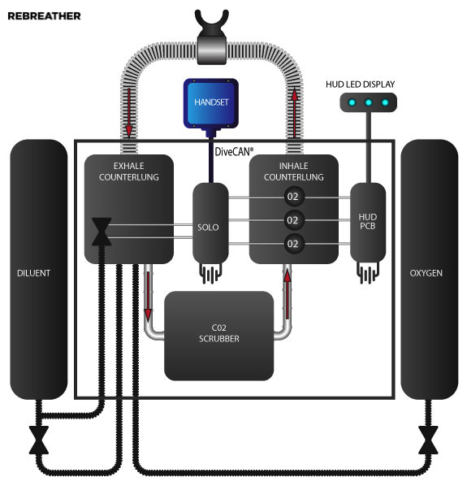
Rebreathers
Rebreather: self-contained underwater breathing apparatus.
Advantages:
being more gas efficient
making longer and deeper dives possible
Disadvantages:
Reuse of breathing gases make users more susceptible to
hypoxia (low O₂)
hyperoxia (high O₂)
hypercapnia (CO₂ toxicity)
Mixed-gas closed-circuit recreational rebreather
ASSURE 2013 Workshop  Creating Safety Assurance Cases for Rebreather Systems  3

Slide 4
Rebreathers
Case study:
Shearwater’s DiveCAN®:
method of digital communication
power supply distribution
device management mechanism
ASSURE 2013 Workshop  Creating Safety Assurance Cases for Rebreather Systems  4

Slide 5
Rebreather Safety History
Pioneers of the sport try to determine safety.
Knowledge transfer on rebreatherslist mailing list.
No consensus on the concept of safety.
Basic reliability was a major safety improvement.
In the EU, rebreather standard EN 14143 added a normative for IEC 61508.
IEC 61508 not applicable to emerging technologies.
Inclusion of “Annex B” in EN 14143.
Analysis of functional safety for a device with high level of human interaction.
ASSURE 2013 Workshop  Creating Safety Assurance Cases for Rebreather Systems  5

Slide 6
Goal
Share our experience in creating a safety assurance case for the rebreather sub-system DiveCAN:
Use (1) safety arguments, (2) confirmation arguments and (3) compliance arguments.
Use Goal Structuring Notation (GSN).
ASSURE 2013 Workshop  Creating Safety Assurance Cases for Rebreather Systems  6

Slide 7
System and Safety Development Process
ASSURE 2013 Workshop  Creating Safety Assurance Cases for Rebreather Systems  7

Slide 8
System and Safety Development Process
The system development lifecycle is enhanced by:
Regular peer-reviews
Reviews from safety authority on site
Reviews from external consultants
Independent review of safety requirements
ASSURE 2013 Workshop  Creating Safety Assurance Cases for Rebreather Systems  8

Slide 9
System and Safety Development Process
The results from the safety analyses can have a direct impact at each stage of the system's development process:
Hazard analysis, risk assessment, and safety argument can influence requirements, design and testing activities.
ASSURE 2013 Workshop  Creating Safety Assurance Cases for Rebreather Systems  9

Slide 10
System and Safety Development Process
The results from the system's development can influence the evolution of the safety process:
Validate safety claims.
Indicate potential problems and required changes to safety assumptions or claims.
ASSURE 2013 Workshop  Creating Safety Assurance Cases for Rebreather Systems  10

Slide 11
System and Safety Development Process
A rebreather system's safety goal is to assist in the maintenance of a safe PPO2 in the breathing loop.
The safety goal for DiveCAN® is to provide:
predictable critical data transmission that is resilient to electrical interference;
the optional ability of power distribution such that there is no single point of failure in the supply of power that results in the loss of critical data;
the ability to minimize the possibility that any DiveCAN® node is inactive when life-support depends upon action of the node.
ASSURE 2013 Workshop  Creating Safety Assurance Cases for Rebreather Systems  11

Slide 12
System and Safety Development Process
There are several hazards for rebreather divers, such as hypoxia and hyperoxia.
The identification of hazards for a sub-system focus on how the sub-system can contribute to rebreather hazards. For DiveCAN®:
H1. Delay of critical data
H2. Loss of critical data
H3. Corruption of critical data
H4. Loss of power
H5. Wakeup status not propagated
ASSURE 2013 Workshop  Creating Safety Assurance Cases for Rebreather Systems  12

Slide 13
System and Safety Development Process
The method for risk assessment is performed in terms of three variables:
Severity: evaluation of the worst plausible harmful consequence given the occurrence of a failure mode or other hazard cause.
Likelihood: possibility of the actual occurrence of a failure mode or other hazard cause.
Controllability: possibility that the diver could intervene to prevent or reduce the harmful consequence.
ASSURE 2013 Workshop  Creating Safety Assurance Cases for Rebreather Systems  13

Slide 14
Goal Structuring Notation (GSN) for Safety and Confidence Arguments
ASSURE 2013 Workshop  Creating Safety Assurance Cases for Rebreather Systems  14

Slide 15
Goal Structuring Notation (GSN) for Safety and Confidence Arguments
Our use of GSN compelled domain experts to re-examine fundamental questions about what claims could be rightfully made about the safety of DiveCAN®.
ASSURE 2013 Workshop  Creating Safety Assurance Cases for Rebreather Systems  15

Slide 16
Goal Structuring Notation (GSN) for Safety and Confidence Arguments
Use of GSN made it easier for us to check the relationship of the identified hazards with the safety claims made about the system.
H3
ASSURE 2013 Workshop  Creating Safety Assurance Cases for Rebreather Systems  16

Slide 17
Goal Structuring Notation (GSN) for Safety and Confidence Arguments
Use of GSN provided the means to discuss and identify the context and the assumptions under which these safety claims hold.
ASSURE 2013 Workshop  Creating Safety Assurance Cases for Rebreather Systems  17

Slide 18
Goal Structuring Notation (GSN) for Safety and Confidence Arguments
The confidence argument discusses issues of sufficiency and completeness of the development and safety process.
To avoid confirmation bias:
Constant questioning of arguments.
Analysis and documentation of what to include and exclude in the system to increase safety.
ASSURE 2013 Workshop  Creating Safety Assurance Cases for Rebreather Systems  18

Slide 19
Compliance Arguments
ASSURE 2013 Workshop  Creating Safety Assurance Cases for Rebreather Systems  19

Slide 20
Compliance Arguments
The compliance argument explains how a safety assurance case meets the clauses of a standard.
Argument is included in our safety assurance case as a traceability matrix of the system under consideration with respect to EN 14143 Annex B.
In compliance with clause B.2, the DiveCAN® software has been developed using a systematic lifecycle. Refer to section 3 in the DiveCAN® safety case document, where there are subsections related to each of the key stages listed in clause B.2 of EN 14143 Annex B.
ASSURE 2013 Workshop  Creating Safety Assurance Cases for Rebreather Systems  20

Slide 21
Conclusions
ASSURE 2013 Workshop  Creating Safety Assurance Cases for Rebreather Systems  21

Slide 22
Conclusions
Creating a safety assurance case for a rebreather system
Use of (1) safety arguments, (2) confirmation arguments and (3) compliance arguments and Goal Structuring Notation (GSN)
Challenged us to understand how safety risk is addressed and what residual risks are left.
Compelled domain experts to re-examine and refine claims made about the safety of the system.
Activity worth the time and money.
Alma Juarez – aljuarez@gmail.com
Bruce Partridge – bruce@shearwaterresearch.com
Jeff Joyce– jeff.joyce@cslabs.com
ASSURE 2013 Workshop  Creating Safety Assurance Cases for Rebreather Systems  22

