Slide 1
An evaluation of argument patterns to reduce pitfalls of applying Assurance Case
Prof. Dr. Shuichiro Yamamoto
Nagoya University
1
Notes:
13:00 -- 13:30 Architecture and Assurance Cases S. Yamamoto

Slide 2
Agenda
Pitfalls of assurance case deployment
Patterns of argument decomposition
Early evaluations of pattern applications
Future plan

Slide 3
Assurance case pitfalls
Necessity of Decomposition Pattern

Slide 4
Pitfalls
Fundamental Challenges
Confusion of Argument Structure & Control Structure
Controlling the Represented Range
Diversity of Decomposition Approaches

Slide 5
Claim decomposition
What should the claim be and how should it be expressed?
What should be written as strategies?
How much should the argument be decomposed using the strategies?
What should be written as context?
What should be written as evidence?
How far should the hierarchical structure be extended?
How should the relationships between context and evidence be analyzed?

Slide 6
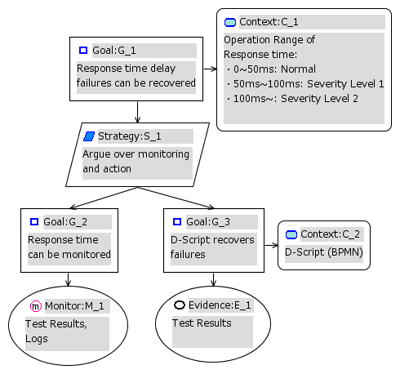
Assurance case ambiguity
Goal ？
Strategy？
Relationship?
Context？
Depth?
Width？
Evidence ？
Sentence？

Slide 7
Confusion of Argument Structure & Control Structure
Mixing up of strategies and goals.
Content that should be written as a claim being expressed in the form of an action or function statement rather than as a proposition.
Misunderstanding of strategies as judgment branches.
Decomposing into function execution sequences instead of arguments.

Slide 8
Controlling the Represented Range
This does not extend to cover measures taken regarding maintenance of the train itself or the dangers associated with maintenance work.

Slide 9
Basic pattern of argument decomposition
Architecture
Functional
Attributes
Infinite set
Complete
Monotonic
concretion
Notes:
Robin Bloomfield and Peter Bishop, Safety and Assurance Cases: Past, Present and Possible Future – an Adelard Perspective
Architecture
functional
Attributes
Infinite set
complete
monotonic
concretion

Slide 10
Formal Claim Decompositions
types | explanation
Architecture | splitting a component into several sub-components
functional | splitting a component into several sub-functions
Attributes | splitting a property into several attributes
Infinite set | inductive partitioning from a base case (e.g., over time)
complete | capturing the full set of values for risks, requirements, etc.
monotonic | the new system only improves on the old system
concretion | making informal statements less vague
Robin Bloomfield and Peter Bishop, Safety and Assurance Cases: Past, Present and Possible Future – an Adelard Perspective

Slide 11
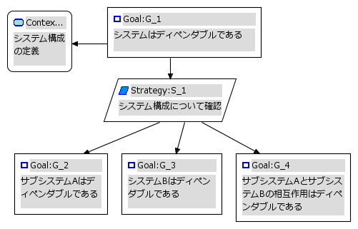
Architecture decomposition
System
architecture
design
System is dependable
Argument over System architecture
Sub system A is dependable
Sub system B is dependable
Interactions between A and B are dependable

Slide 12
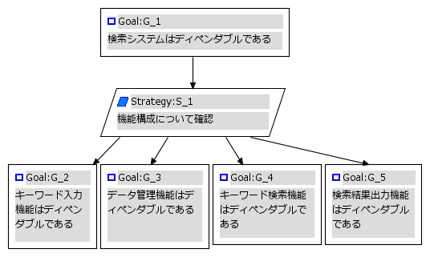
Functional decomposition
Search system is dependable
Argument over functions
Keyword input function is dependable
Data management function is dependable
Keyword search function is dependable
Result of search function is dependable

Slide 13
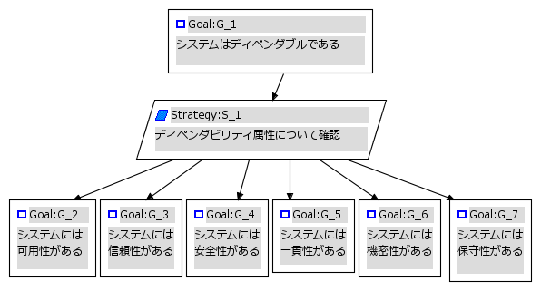
Attribute decomposition
Search system is dependable
Search system is dependable
Argument over quality attributes
System is available
System is reliable
System is safe
System is consistent
System protects confidentiality
System is maintainable

Slide 14
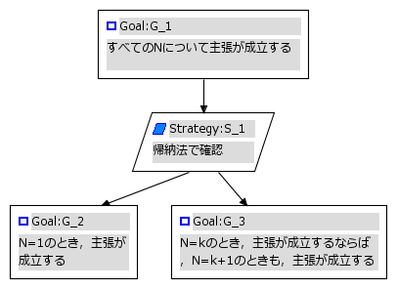
Infinite set decomposition
Claim holds for every N
Argument over induction
Claim holds for N
If Claim holds for N, then it also holds for N+1
[K=1] The claim holds
[K=N]If the claim holds for N, then it also holds for K=N+1

Slide 15
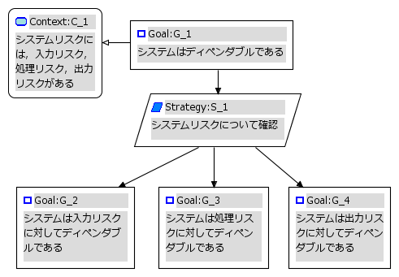
Complete decomposition
System risk includes input, process and output risks
System is dependable
Argument over risk
System is dependable for input risk
System is dependable for process risk
System is dependable for process risk

Slide 16
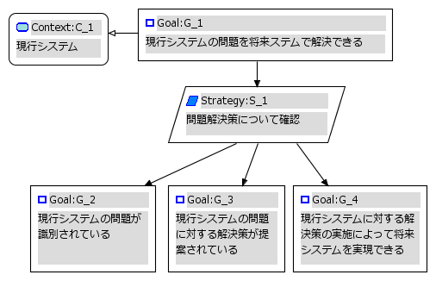
Monotonic decomposition
As-is System
As-is System problem is resolved in the To-be system
Argument over As-is System problem
As-is System problem is identified
Solution is proposed to resolve As-is System problem
To-be system can be realized by implementing Solution for resolve As-is System problem
Notes:
参考）問題解決では，現行システムから将来システムへの一方向性があるので単調分解という

Slide 17
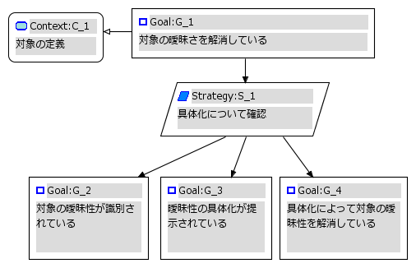
Decomposition by concretion
Definition of object
Ambiguity of object is resolved
Argument over concretion
Ambiguity of object is identified
Concretion of object is provided
Ambiguity of object is reduced by the concretion

Slide 18
Evaluation of the decomposition patterns

Slide 19
Design of experiment
Examinee is an engineer who has more than 20 years experience in the embedded system development.
4 hour course of assurance case education was provided to the examinee.

Slide 20
The content of the course text
Introduction to assurance case 10 pages
Assurance case development method 26 pages
Assurance case exercises 15 pages
Argument decomposition patterns 15 pages

Slide 21
Case study: LAN device monitoring
Sensors
valid
LAN device
P１
Network
Manager
LAN
P3
invalid
LAN device
P2
Monitor sensors
1000 LAN devices for each sensors
2000 sensors
Interactions | description
P1 | ① Initial packets to LAN devices ② Get names and information
P2 | ① Initial packets to abnormal LAN devices ② Interception
P3 | ① Set up sensors ②Validate sensor status ③ Update sensor software ④ Update interception table

Slide 22
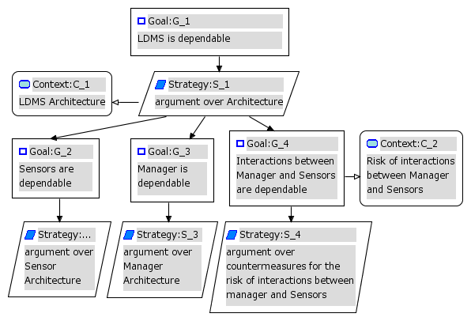
Example of architecture decomposition

Slide 23
Number of nodes
Architecture elements |  | Context | Claim | Strategy | Evidence
Sensor | Power unit | 1(16) | 83 | 30 | 71
 | Main board | 1(17) | 60 | 21 | 42
 | HW case | 1(6) | 20 | 7 | 13
 | HW interaction | 1(16) | 54 | 18 | 43
 | Software | 1(25) | 124 | 41 | 60
 | HW- SW Interaction | 1(11) | 35 | 11 | 27
Manager | HW | 1(4) | 13 | 4 | 10
 | SW | 1(18) | 56 | 18 | 38
 | HW- SW Interaction | 1(8) | 24 | 8 | 16
Interaction between sensors and manager |  | 1(23) | 70 | 23 | 48
Total |  | 10(144) | 539 | 181 | 368
*） ( number ) shows the number of hazards described in Context

Slide 24
Man hours for work categories
Specification Analysis 5
Pattern selection 30
Architecture decomposition 10
Risk analysis 62
D-Case description 110
Total 217
Notes:
LANアプリケーションの機能と構成の概要の整理
2 14 5 28 51

Slide 25
Relationship between claim and evidence
evidence
claim

Slide 26
Relationship between claim and strategy
Strategy
Claim

Slide 27
Relationship between evidence and context(risk)
Evidence
Electric power device
Risk

Slide 28
Discussions

Slide 29
Effectiveness of argument patterns
As the examinee said, the architecture decomposition pattern was useful to analyze risk, although the decision to choose it from argument decomposition patterns needed time to understand appropriateness between the target system and argument patterns.
Many pitfalls discussed in section 2 were not observed in the course of the experiment.
This also showed the effectiveness of the argument pattern.
Without the knowledge of argument patterns, the examinee could not develop a large assurance case consists of 1098 nodes in 15 days.

Slide 30
Limitations of patterns
Bloomfield's patterns do not, however, take decomposition by process or condition into considerations. For example, in argumentation by conditional judgment, a claim can be decomposed using a strategy such as that shown in Figure 2.
Here, based on evidence, a condition is defined and dependability is verified both for the case where that condition is satisfied and the case where it is not.
In other words, Goal G_4 claims that the condition is defined; Goal G_2 claims that an appropriate action is taken when the condition is satisfied; and Goal G_3 claims that an appropriate action is taken when it is not.

Slide 31
Correlation with System Development & Operation Materials
The correlation between an assurance case’s context and evidence and those documents used in system development and operation has not clearly been defined, leading to a situation where multiple documents and multiple assurance cases have simply been handled at a combined level.
Specific relationships at the element level were thus unclear, and as a result, valuable information from system development and operation documents could not be fully utilized.

Slide 32
Systems, Documentation & Assurance Cases

Slide 33
Creating Assurance Cases for Process Validation
(1)Establish a claim based on the goal.
(2) Argue each procedure necessary to achieve the goal according to the strategy.
(3) Establish input information using contexts.
(4) Establish the verification result for the process output as evidence.

Slide 34
Summary
This paper introduced some of the pitfalls commonly encountered when developing assurance cases, as well as assurance case pattern methods for dealing with them.
Evaluation of the pattern approach was also evaluated for assuring a LAN device management system.
The experimental evaluation showed the effectiveness of the architecture pattern of argument decomposition.
The examinee developed assurance case contains more than 1000 nodes systematically in less than 2 weeks, after learned assurance case introduction course and patterns in 4 hours.
Methods for extending assurances case patterns based on process definition were also discussed.

Slide 35
Thank you for your attention

